Slide 1

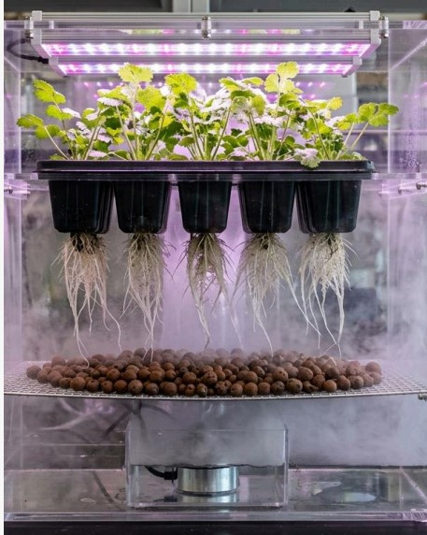
Sustainable Future
F. L . O. R . A
Fog - assisted Light - Integrated Optimized Root Apparatus
Presentation
Insights, Performance & Sustainable Growth Overview
FLORA (Fog Assisted Light Integrated Optimized Root Apparatus) is an innovative smart cultivation system combining nutrient-rich fog delivery, optimized root-zone management, and integrated lighting for efficient, sustainable plant growth.
FLORA enables efficient and sustainable plant cultivation by optimizing root nutrition, reducing water consumption, saving space, improving growth conditions, and supporting controlled, year-round cultivation through integrated lighting.
Presented by: Shreeyog Yembadwar
Team : Floratech
Institution : CSMSS College
of Agriculture

Slide 2



PROBLEM STATEMENT
Sustainable Future
  Agriculture faces serious water scarcity issues.
  Traditional irrigation wastes large amounts of water.
  Aeroponics is efficient but too expensive and complex.
  Low-cost fog systems cause root rot due to heavy droplets.raph text

Slide 3
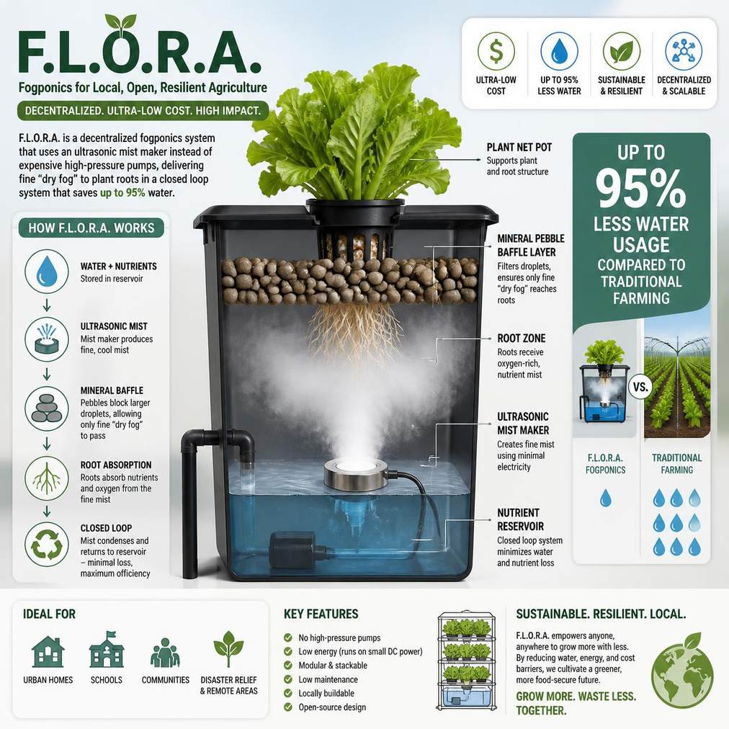
Our Solution
Sustainable Future
  We propose F.L.O.R.A., a decentralized and ultra-lowcost fogponics system.
  It uses an ultrasonic mist maker instead of expensive highpressure pumps.
  A mineral pebble baffle layer ensures only fine “dry fog” reaches plant roots.
  The system operates in a closed loop, minimizing water and nutrient loss.
  It can reduce water usage by up to 95% compared to traditional farming.

Slide 4
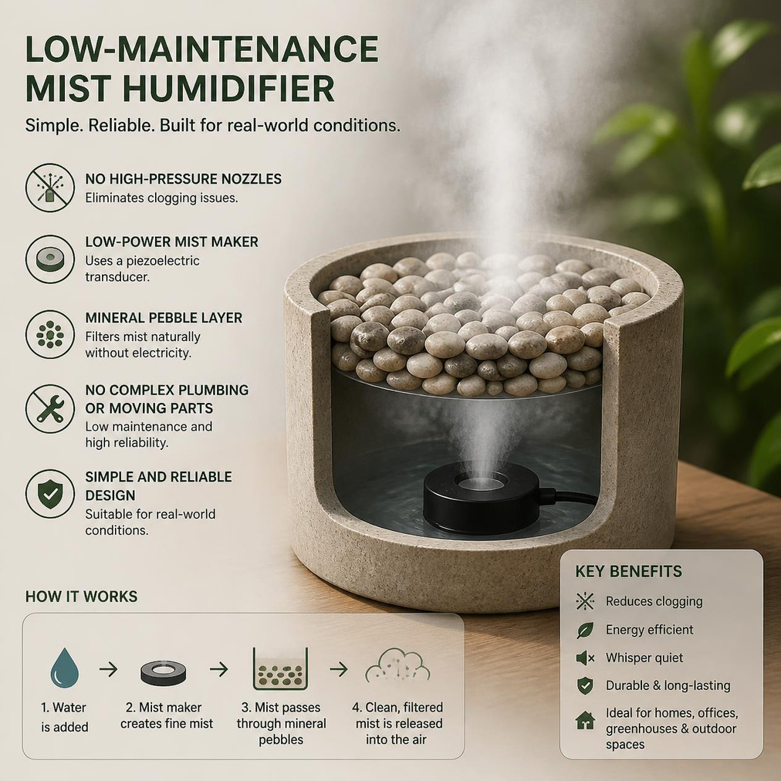
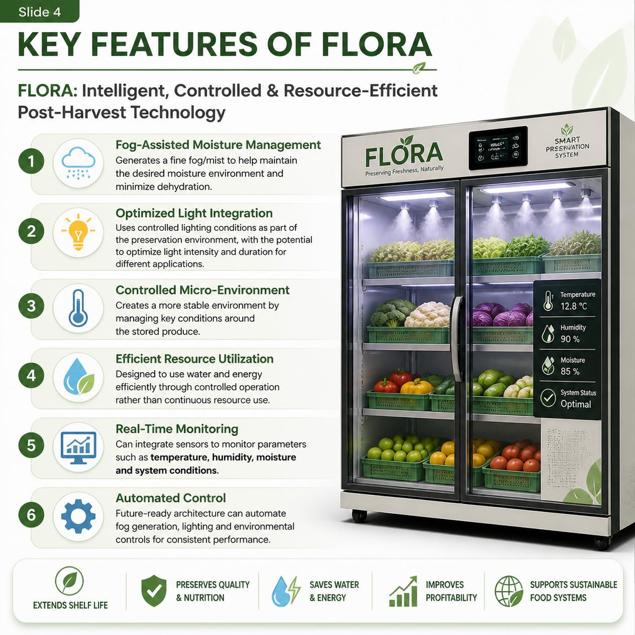
FEASIBILITY
& Key Features

Slide 5
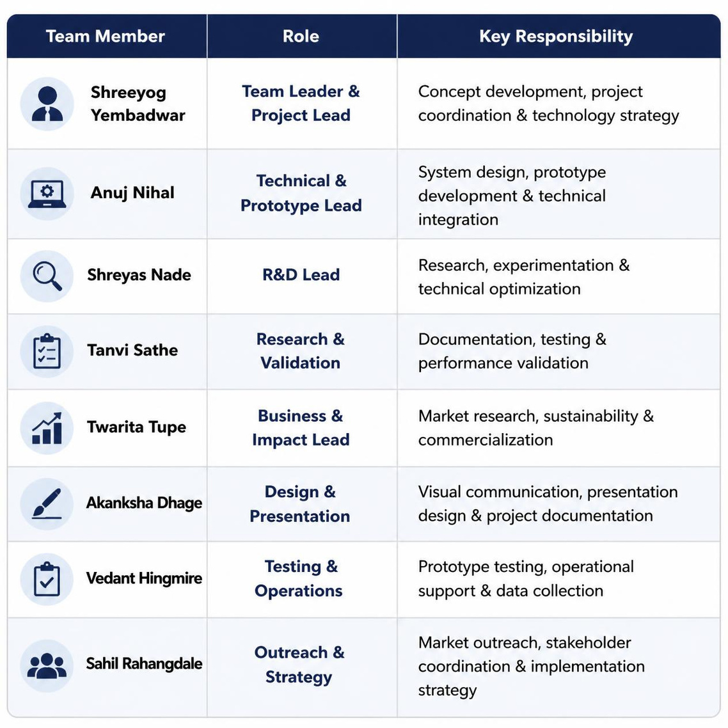
Team Structure
Roles
Responsibilities

Slide 6
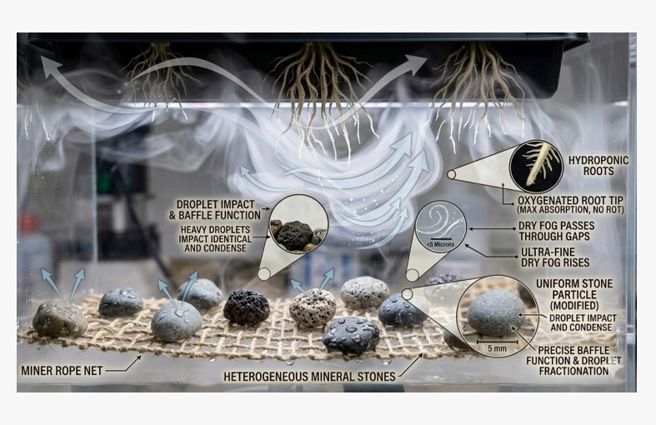
CORE
INNOVATION
The aluminum mesh and mineral pebble layer is our primary innovation. It acts as a passive mechanical sieve
. It guarantees that roots only receive highly oxygenated "dry fog" (under 5 microns), entirely eliminating the root rot associated with standard fogponic systems.
Any unabsorbed mist condenses on the enclosure walls or the baffle layer and drips straight back into the reservoir.
Zero water is lost to deep percolation or evaporation

Slide 7
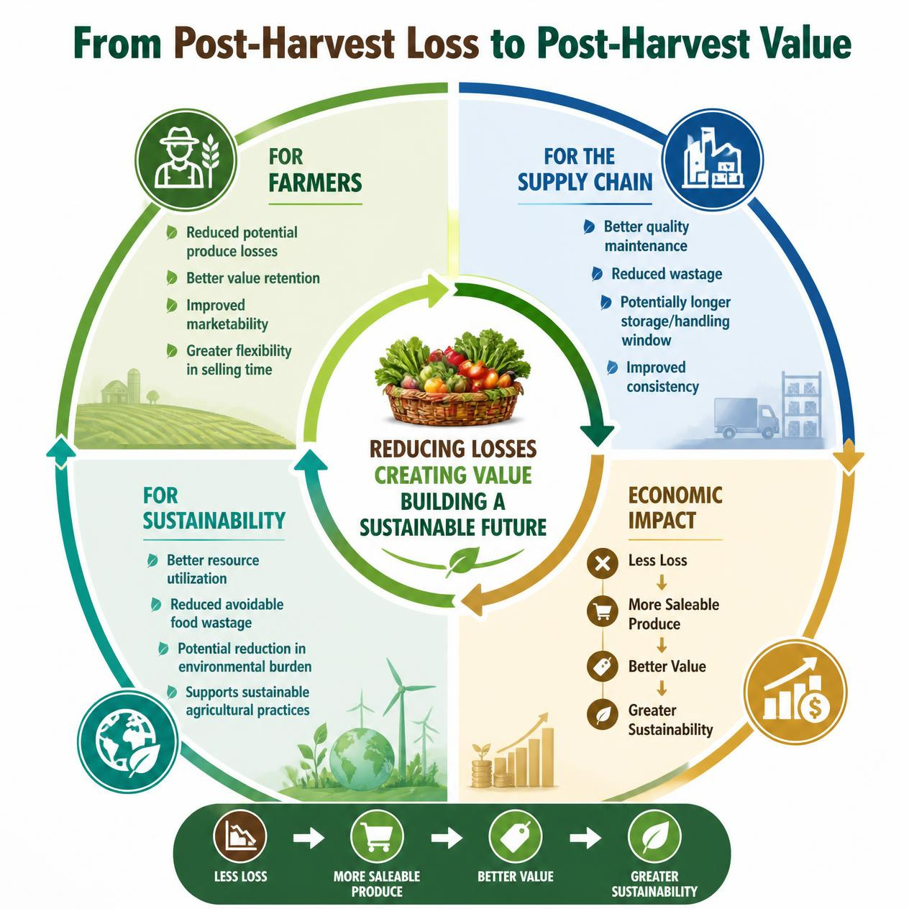
Impact and Benefits

Slide 8
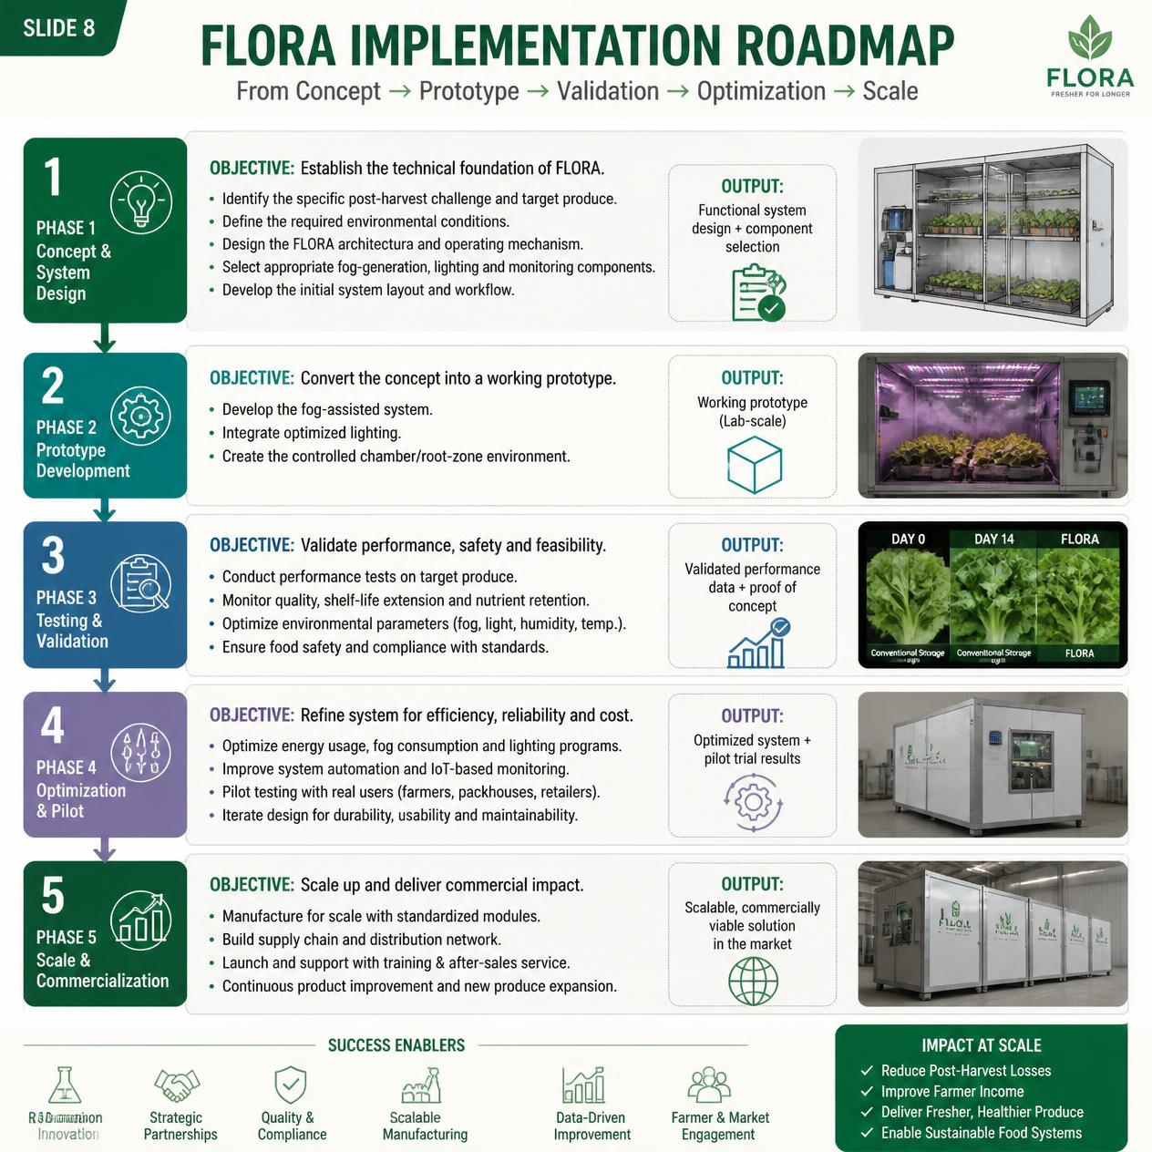
Implementation
Roadmap

Slide 9
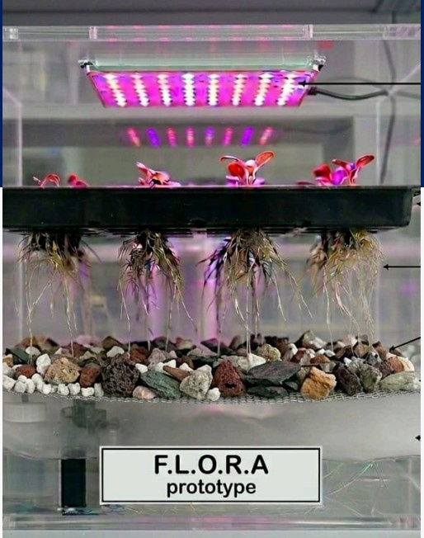
WORKING MECHANISM
Sustainable Future
  The system operates inside a sealed transparent chamber.
  An ultrasonic mist maker converts nutrient-rich water into a dense fog.
  This fog passes through a layer of mineral pebbles, which filter out heavy droplets.
  Only ultra-fine dry fog reaches the plant roots, ensuring high oxygen availability.
  Unused moisture condenses and returns to the reservoir, creating a continuous recycling loop.

Slide 10
DELIVERABLES
(PROTOTYPE)
For the live prototype testing and final presentation, our team will deliver:
1.A complete prototype of the F.L.O.R.A. bio-reactor demonstrating the closed-loop fertigation cycle.
2.A live visual demonstration of the mist fractionation process using the mineral pebble baffle layer.
3.A live crop demonstration (featuring rapid-growth leafy greens like coriander) showcasing healthy, rot-free root development in a high-oxygen fog environment.
Sustainable Future

Slide 11
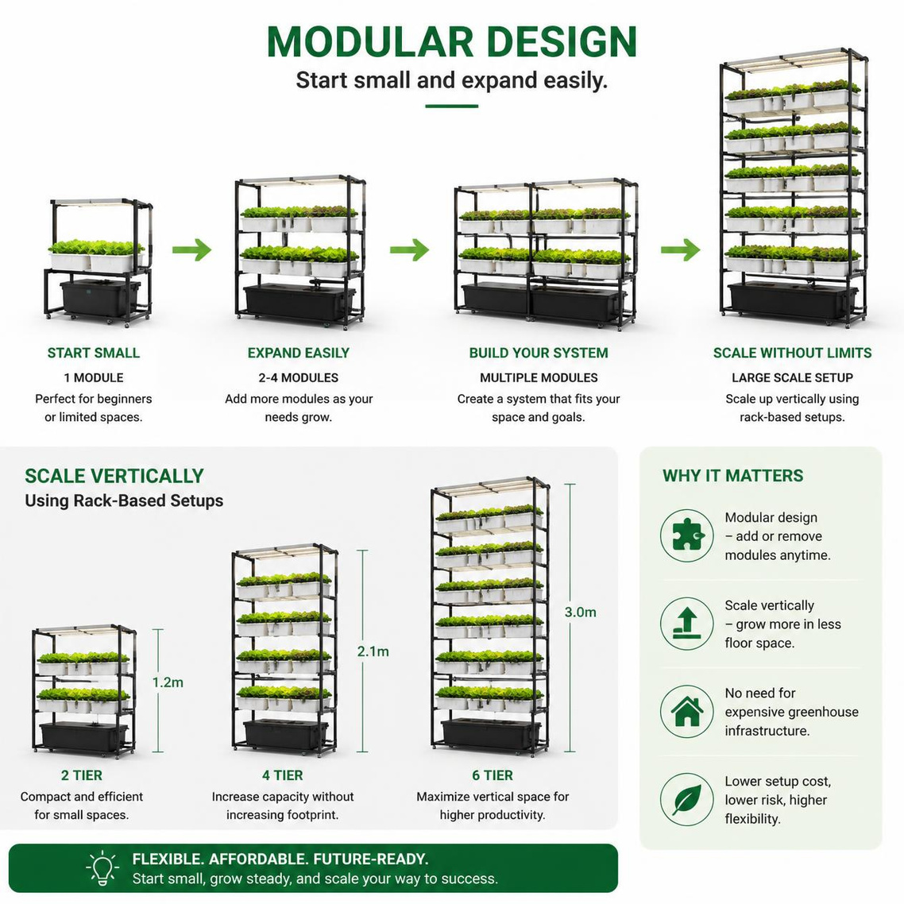
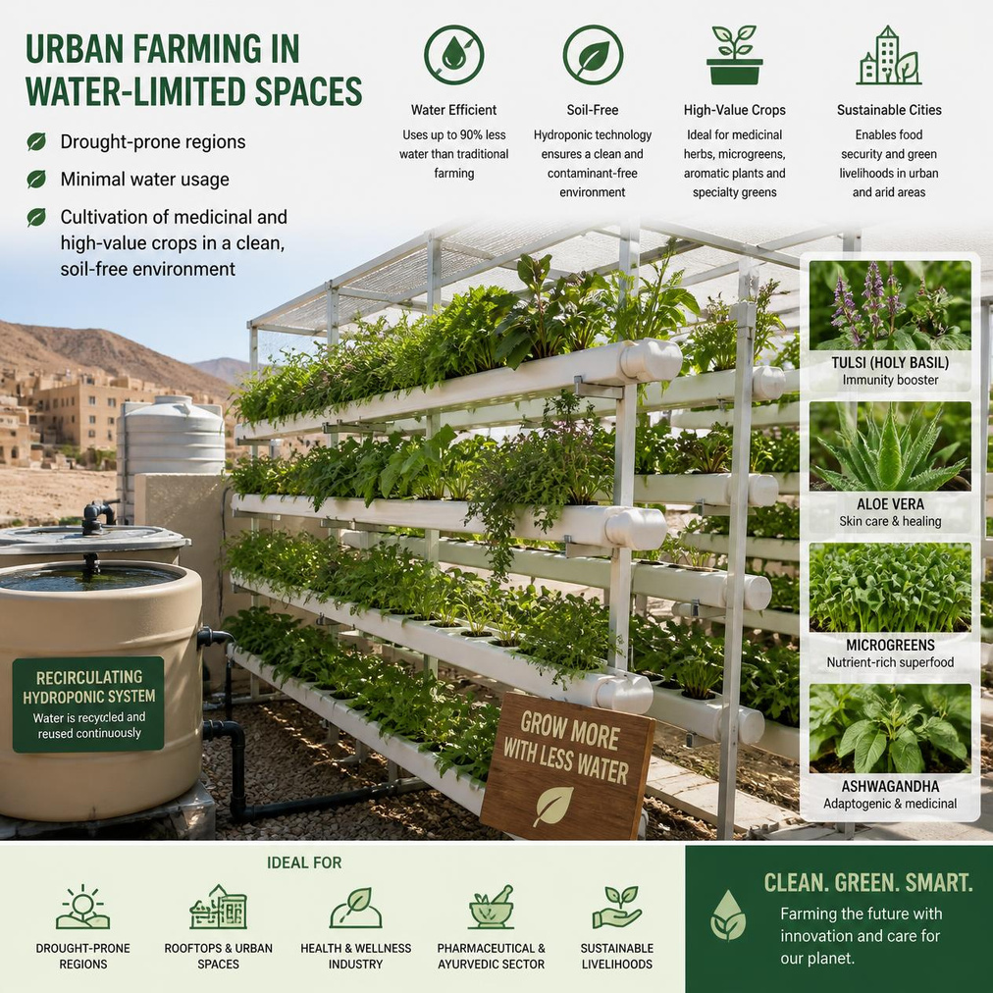
SCALABILITY
& USE CASES

Slide 12
Thank
You
Insights, Performance & Sustainable Growth Overview
FLORA
Fog Assisted Light Integrated Optimized Root Apparatus
Growing Smarter. Growing Sustainably.
Presented by:
Shreeyog Yembadwar

